Slide 1
Clustering
k-Means
Algorithms

Slide 2
Project planning
01
03
Steps Clustering with k-means algorithm
type of machine learning
02
why did you choose unsupervised learning ?
04
presentation of my code with

Slide 3
1 - Type of machine learning
Supervised learning
Unsupervised learning
Reinforcement learning
Supervised learning involves learning from labeled (etiquette) data, where the algorithm is trained on a dataset that includes both input variables x input y output .
Unsupervised learning involves learning from unlabeled data, where the algorithm is trained on a dataset that only includes input variables. The goal is to discover patterns, relationship
Reinforcement learning involves learning through interaction with an environment, where the algorithm learns to take actions

Slide 4
2. why did you choose unsupervised learning ?
02
01
Exploration of Data
BigData
Explore our data and identify patterns, relationships
03
Anomaly Detection
04
detect data points that are significantly different from the rest of the data
This type solution when we not have access to labeled data
No Labeled Data

Slide 5
3. Steps Clustering with k-means algorithm
Repeat
steps 2 and 3 until the centroids no longer change or a maximum number of iterations is reached
04
Displaced centroid
Recalculation : Recalculate the centroid of each cluster by taking the mean of all the data points assigned to it
03
Select -
Map each data point to the closest central point based on the Euclidean distance
02
The algorithm outputs the K clusters and their respective centroids.
01
Initialization
Number of clusters “K” eq number of centroid

Slide 6
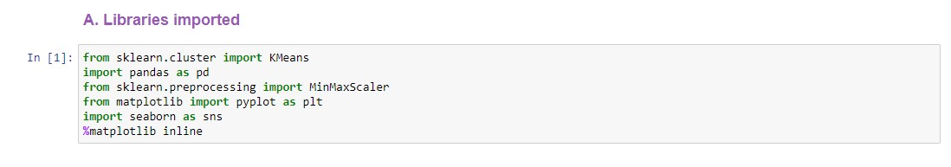
4. Presentation of my code with

Slide 7
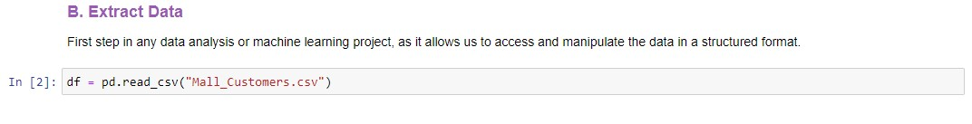
4. Presentation of my code with

Slide 8
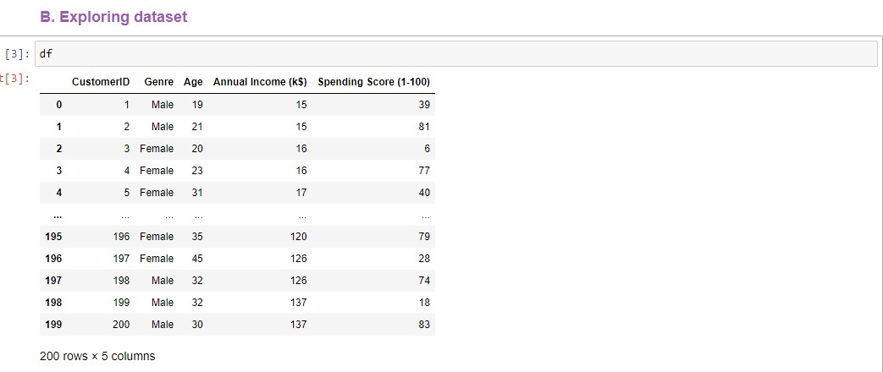
4. Presentation of my code with

Slide 9
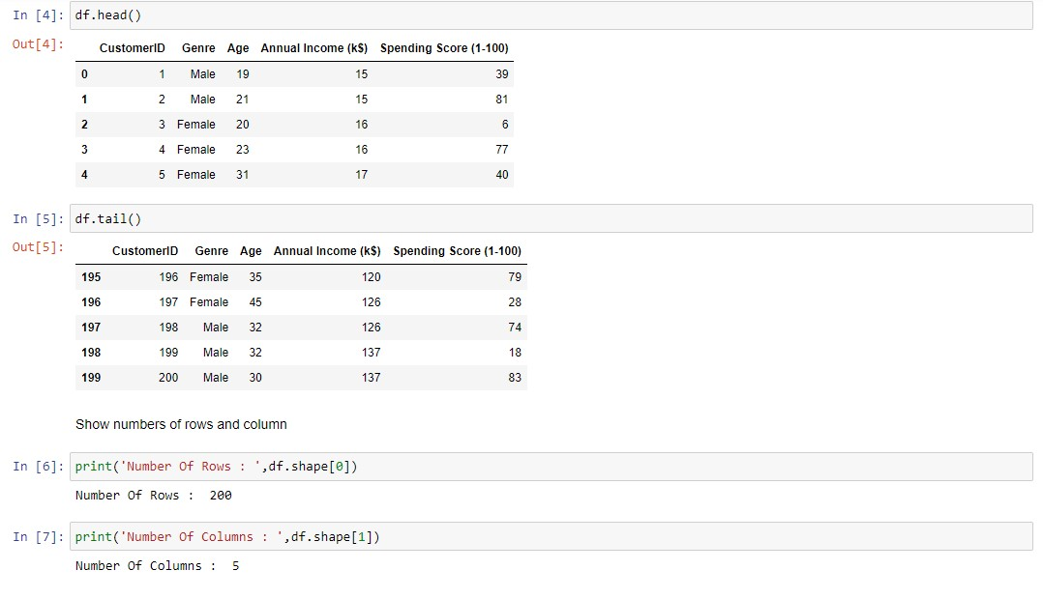
4. Presentation of my code with

Slide 10
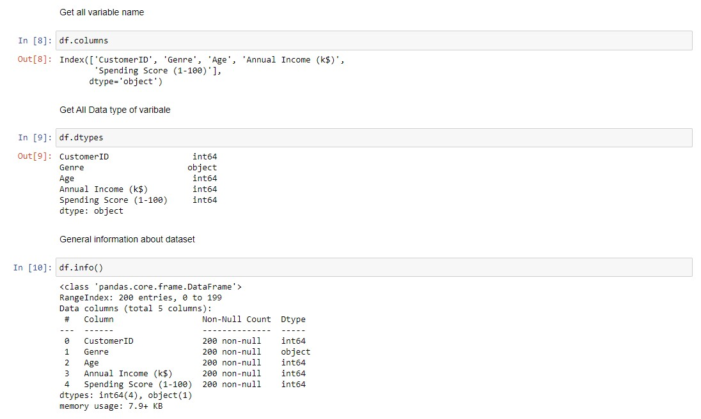
4. Presentation of my code with

Slide 11
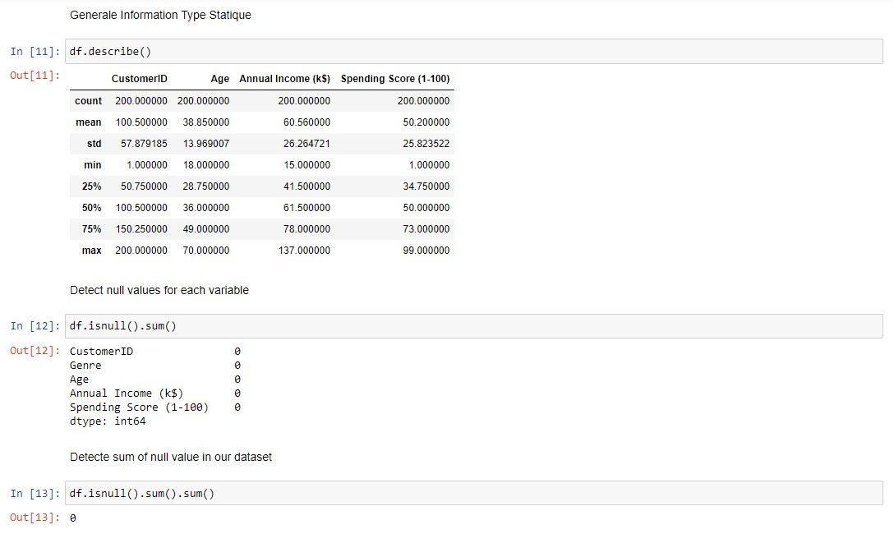
4. Presentation of my code with

Slide 12
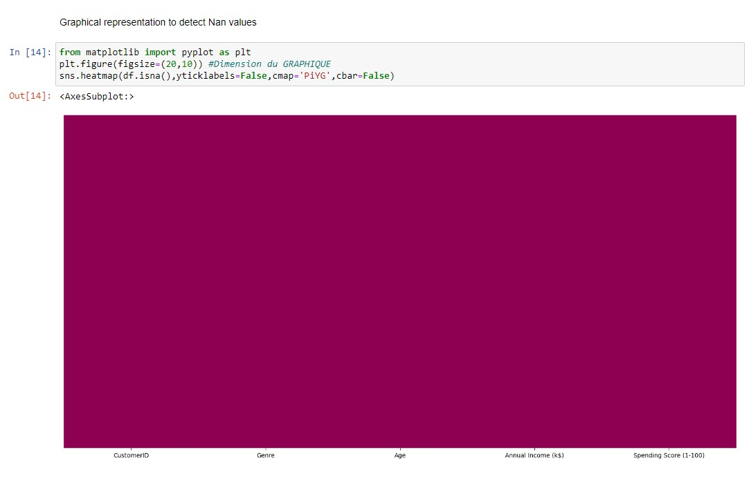
4. Presentation of my code with

Slide 13
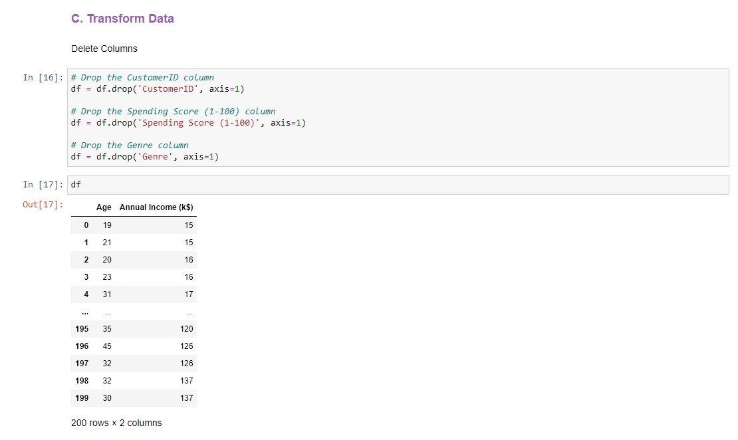
4. Presentation of my code with

Slide 14
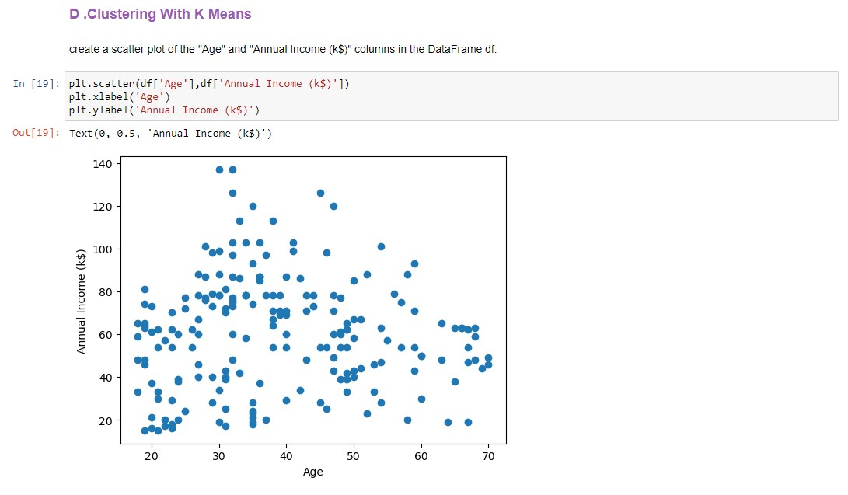
4.1 start k- means algorithm

Slide 15
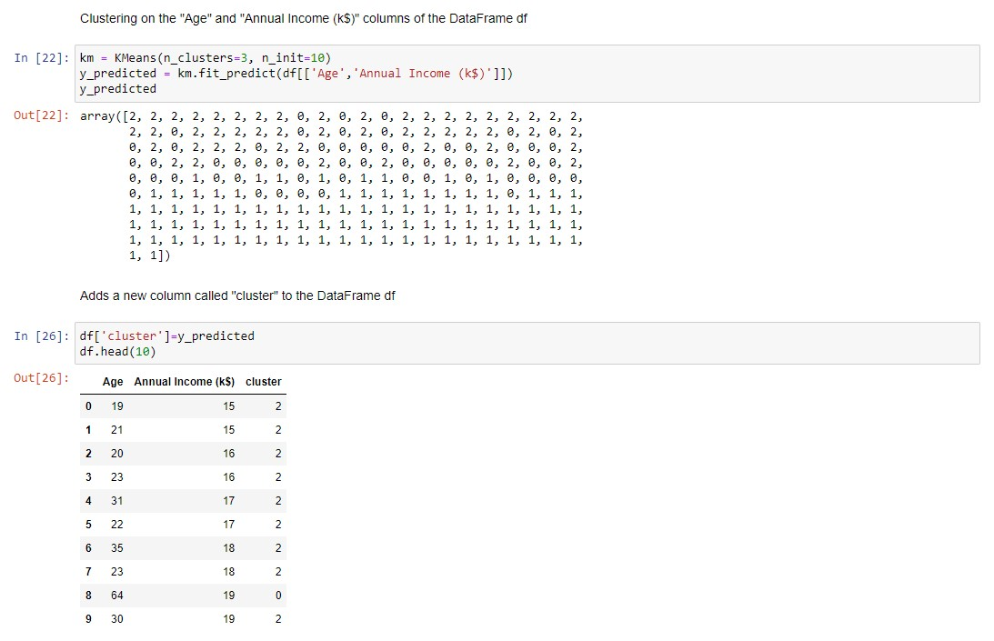
4.1 start k- means algorithm

Slide 16
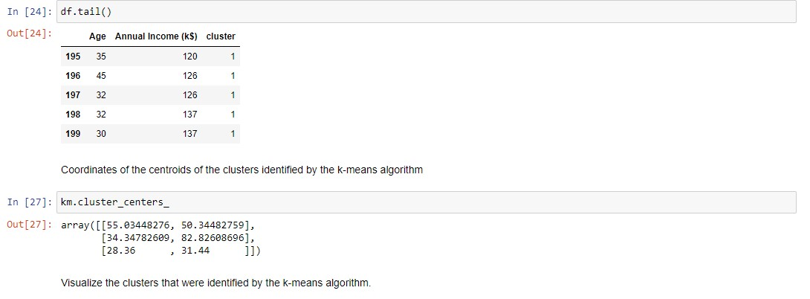
4.1 start k- means algorithm

Slide 17
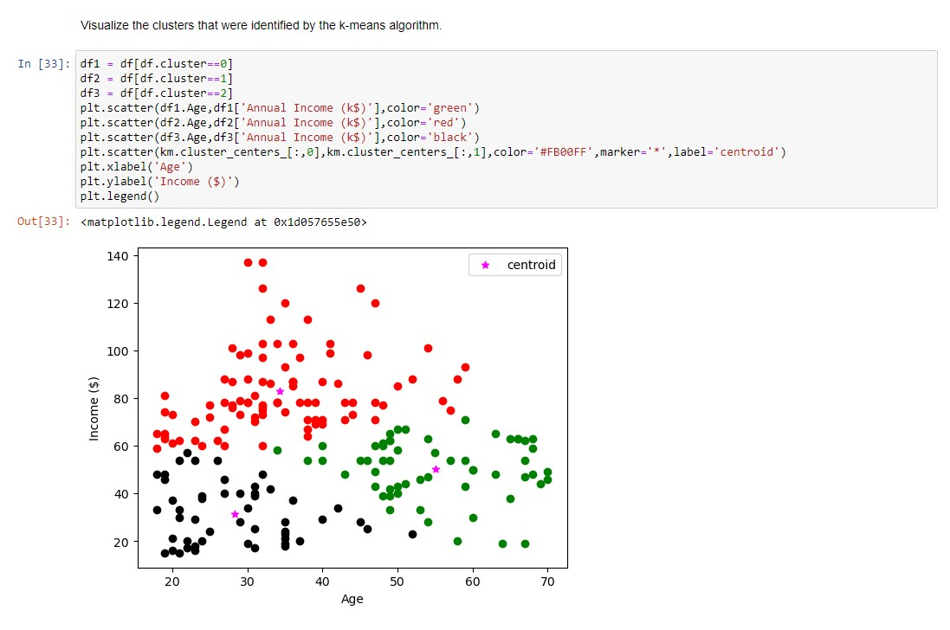
4.1 start k- means algorithm

Slide 18
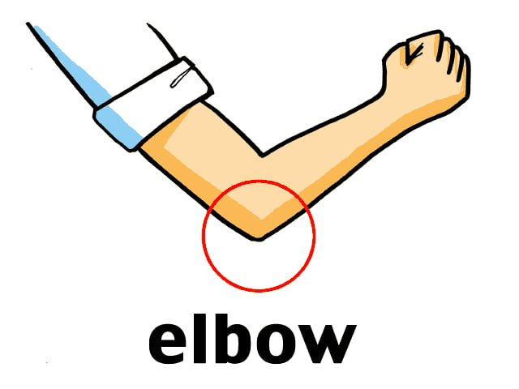
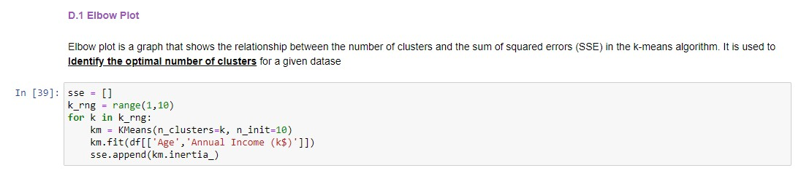
4.1 start k- means algorithm with elbow plot

Slide 19
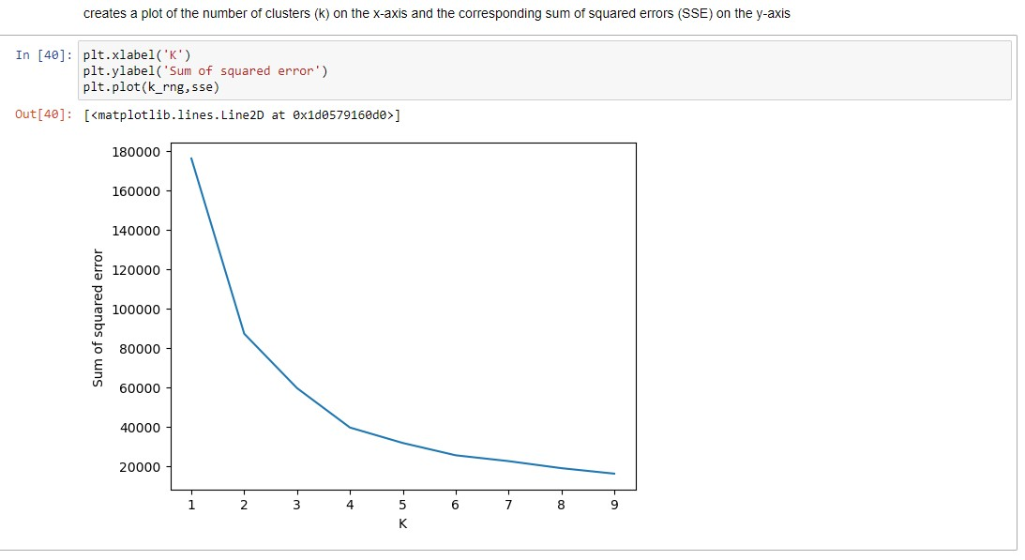
4.1 start k- means algorithm

Slide 20
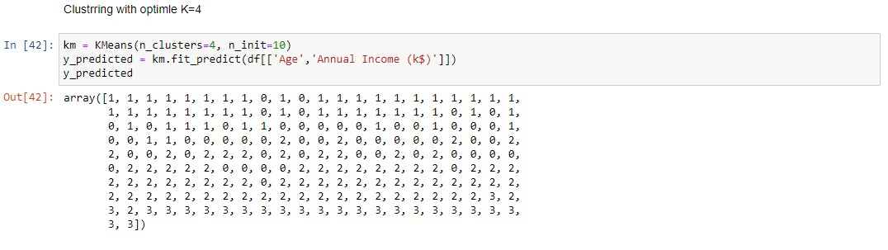
4.1 start k- means algorithm

Slide 21
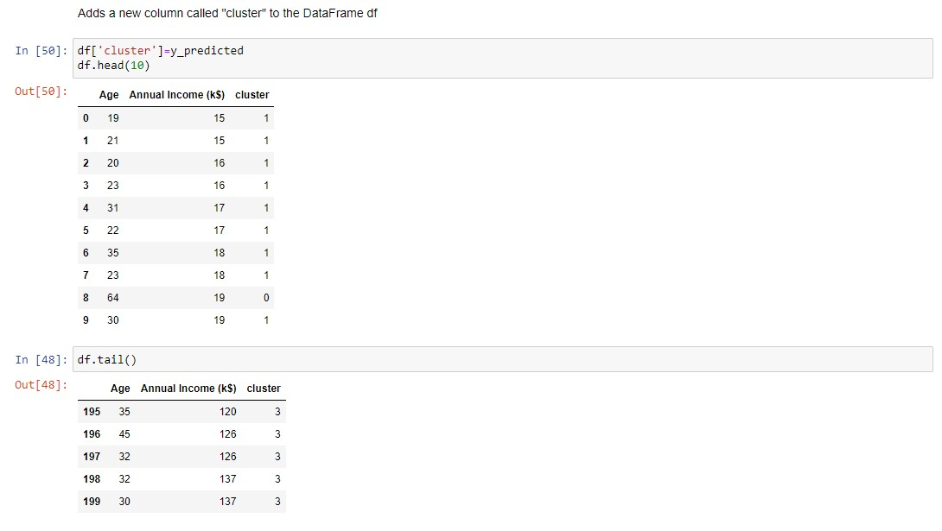
4.1 start k- means algorithm

Slide 22
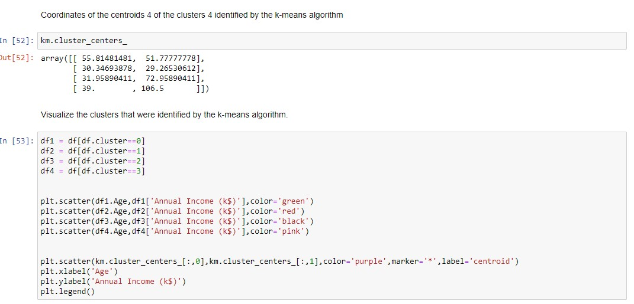
4.1 start k- means algorithm

Slide 23
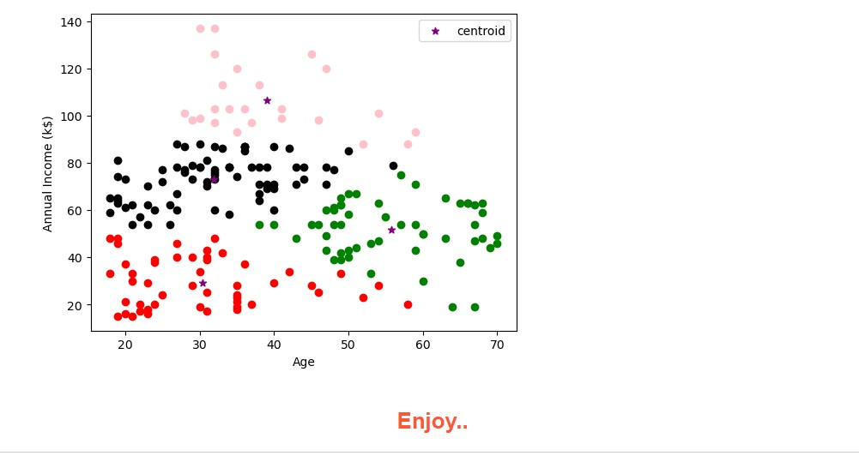
4.1 start k- means algorithm

